Slide 1
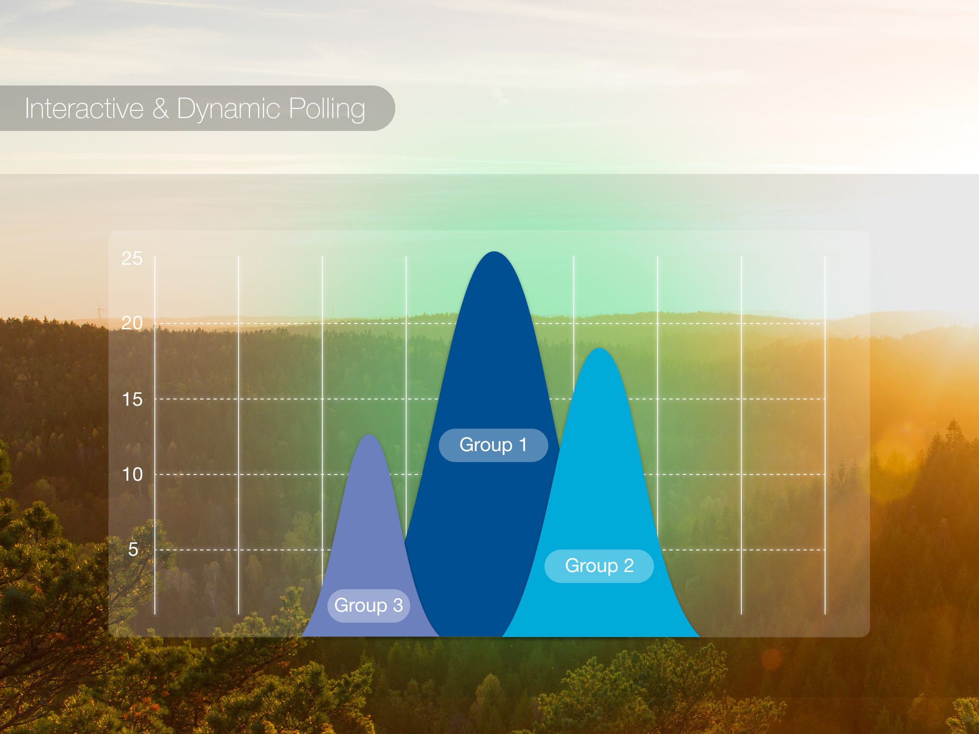

Slide 2
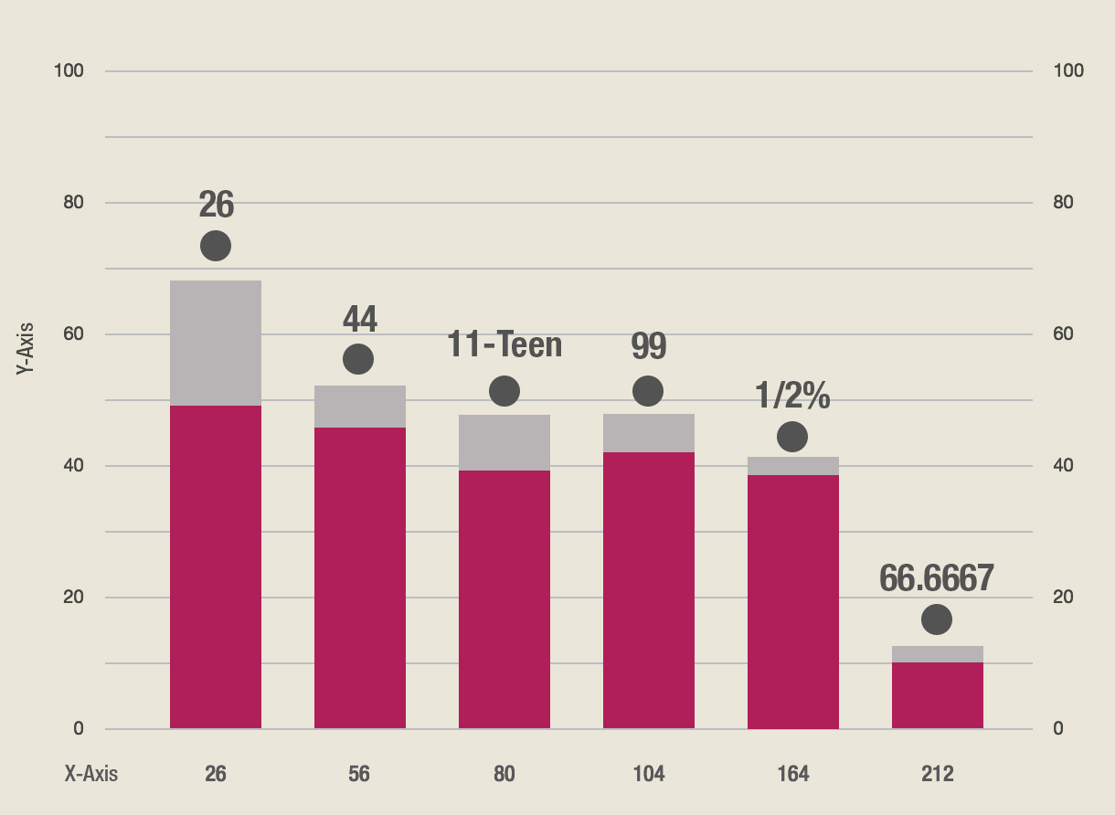

Slide 3
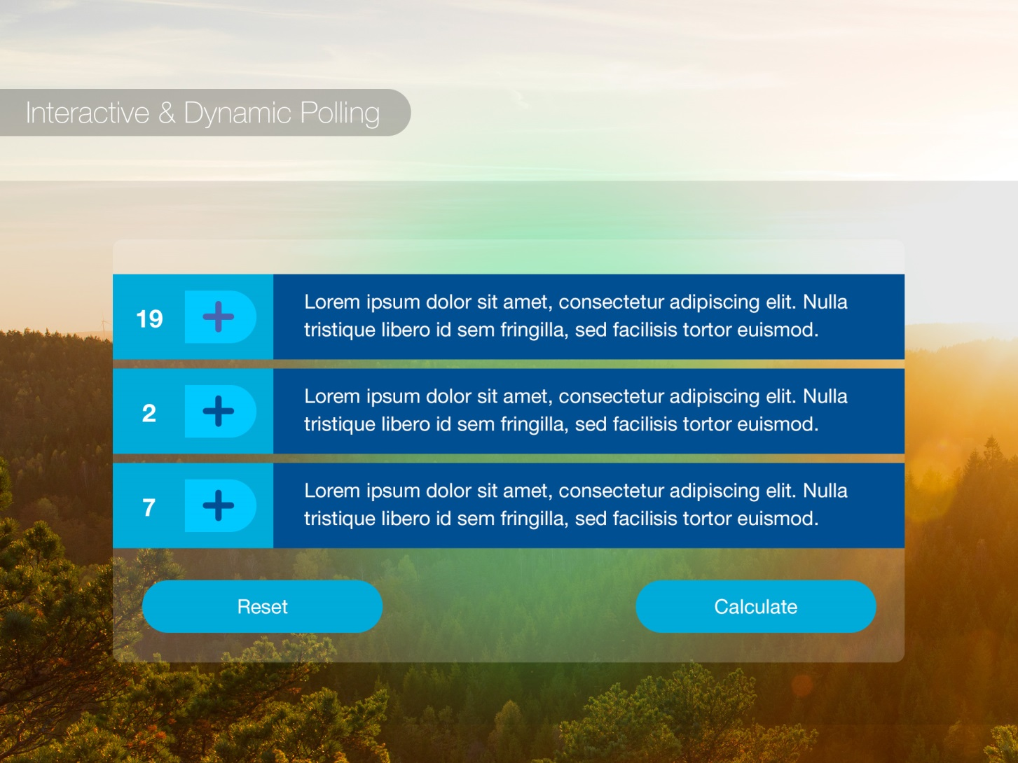

Slide 5
Getting Started
HTML:
<canvas width="700" height="450"></canvas>
Javascript:
<script src="js/TweenMax.min.js" type="text/javascript"></script>

Slide 6
The Canvas
Setting up our Canvas:
Set our Context:
var c = document.getElementByTagName("canvas");
var ctx = c.getContext("2d");
Style the canvas drawing:
ctx.fillStyle = #color; //Set the color to fill the drawn object with
ctx.shadowColor = '#444'; //Set the shadow color
ctx.shadowBlur = 30; //Our blur radius for the shadow to soften it
ctx.shadowOffsetX = 10; //X position of the shadow
ctx.shadowOffsetY = 2; //Y position of the shadow

Slide 7
The Canvas
Setting our starting points:
Clear our canvas:
ctx.clearRect(0, 0, c.width, c.height); //Clear all drawings from the canvas
Start drawing our object:
ctx.beginPath(); //Start drawing a new object to the canvas
Set our starting position:
ctx.moveTo(0, 0); //Sets the first point of our object to draw from

Slide 8
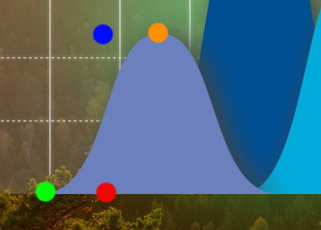
The Shape
We could use a quadratic curve, but it doesn’t really work for our needs. So, we need to work with a Bezier.
ctx.bezierCurveTo(x1, y1, x2, y2, x3, y3); //Draw a Bezier with 4 points
Starting Position [ctx.moveTo(0, 0);]
Point 1 [x1, y1]
Point 2 [x2, y2]
Point 3 [x3, y3]

Slide 9
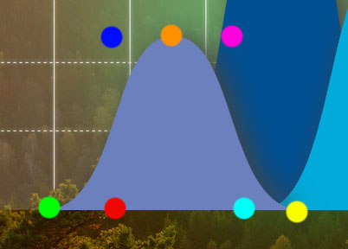
The Shape
We could use a quadratic curve, but it doesn’t really work for our needs. So, we need to work with a Bezier.
ctx.bezierCurveTo(x1, y1, x2, y2, x3, y3); //Draw a Bezier with 4 points
ctx.bezierCurveTo(x4, y4, x5, y5, x6, y6); //Draw a Bezier with 4 points
Starting Position [ctx.moveTo(0, 0);]
Point 1 [x1, y1]
Point 2 [x2, y2]
Point 3 [x3, y3]
Starting Position 2 [x3, y3]
Point 4 [x4, y4]
Point 5 [x5, y5]
Point 6 [x6, y6]

Slide 10
The Canvas
One last piece of the puzzle:
ctx.fill(); //Fill in the area under our points
Alternatively:
ctx.stroke(); //Connect the points without filling in the area below
Also:
ctx.closePath(); //Connect the last point in our path back to our starting point

Slide 11
The Animation
We don’t want a static drawing!
Our Counter:
TweenMax.to(counter.count, 2.5, {count: maxHeight,
onUpdate: animateGraph, ease: Power4.easeOut});
//TweenMax.to(
object to tween,
animation time,
tween options);
Tweens have a default and maximum frame rate of 60/sec.

Slide 12
The Animation
What’s happening in animateGraph?
ctx.clearRect(0, 0, c.width, c.height) ; //Remember me?
ctx.beginPath();
ctx.moveTo(0 + offsetX, verticalBottom);
ctx.bezierCurveTo(0, 0 , width/4, counter.count , width/2, counter.count);
ctx.bezierCurveTo(width*3/4, counter.count , width*3/4, 0 , width, 0);
ctx.fill();

Slide 13
Support
Chrome
Firefox
Safari
iOS Safari
Android Chrome
IE8
IE9+

Slide 14
Questions?
Thanks for listening!

